Slide 1
A Framework for Collaborative Real-Time 3D Teleimmersion in a
Geographically Distributed Environment
Gregorij Kurillo Ramanarayan Vasudevan
Edgar Lobaton ,Ruzena Bajcsy Lisa Wymore,
UC Berkeley
Renata Shepard, Wanmin Wu, Klara Nahrstedt
UIUC, Illinois
Toni Bernardin
UC Davis.
Teleimmersion Lab

Slide 2
Recent Improvements
3D reconstruction we improved the frame rate from 5-10 frames to 20-30 frames due to new representation of the images
Virtual Immersion that shows flexibility of integrating any 3D data with people
Development of a portable Tele-immersive system

Slide 3
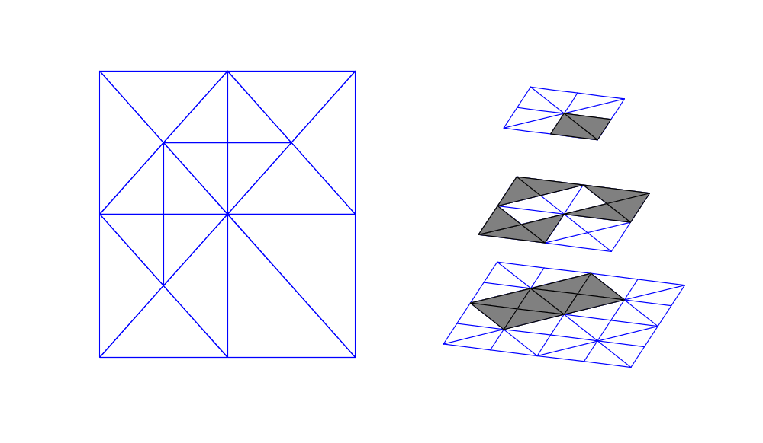
Representation
Images are triangulated using Maubach’s bisection scheme
Big triangles are refined based on variance of grayscale image
Advantages:
  Reduce stereo calculation from pixel-by-pixel to region-by-region
  Fast interpolation where no match is found
  Good compression by encoding structure

Slide 4
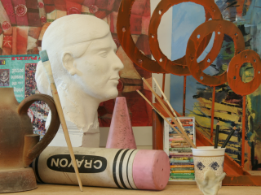
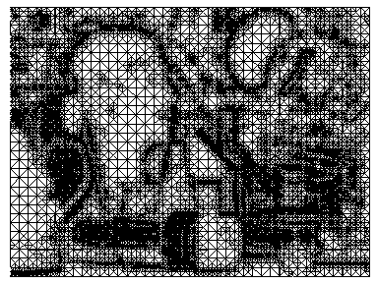
Triangulation

Slide 5
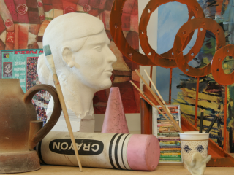
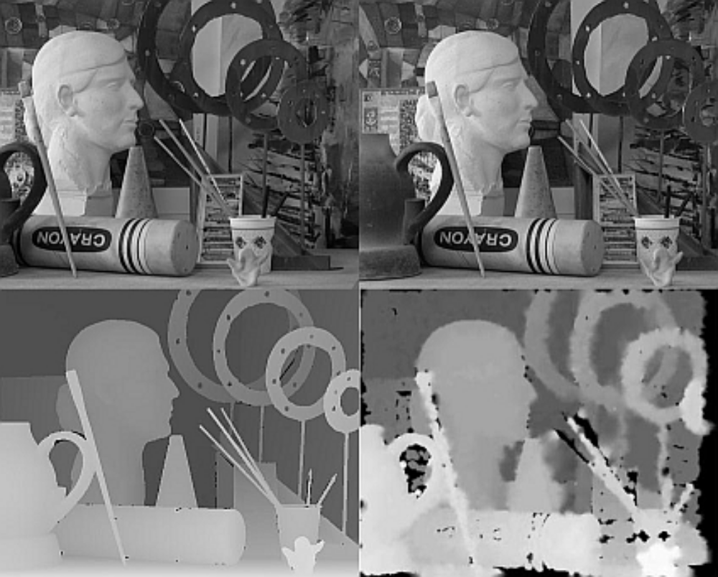
Stereo Results

Slide 6
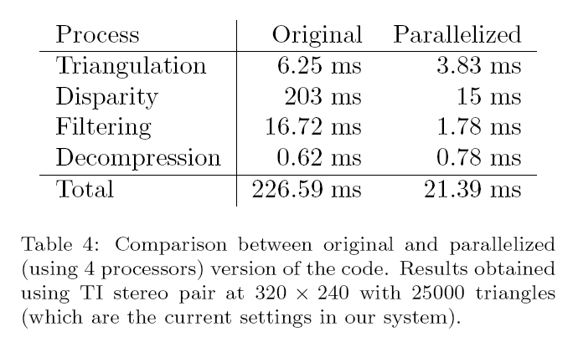
Code Efficiency
*
*S. Jung and R. Bajcsy. A framework for constructing realtime
immersive environments for training physical activities.
Journal of Multimedia, 1(7):9–17, 2006.

Slide 7
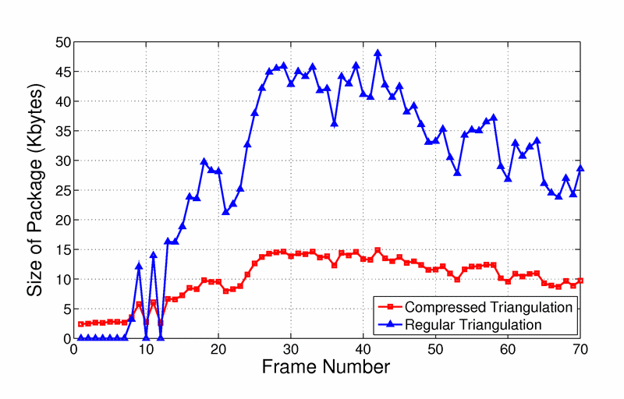
Data Compression
Sending raw data:
  RGB + Disparity (5 bytes), triangle vertices (3 x 3 bytes x num_triangles)
Encoding scheme for triangulation
  How the triangulation was built through bisection scheme

Slide 8
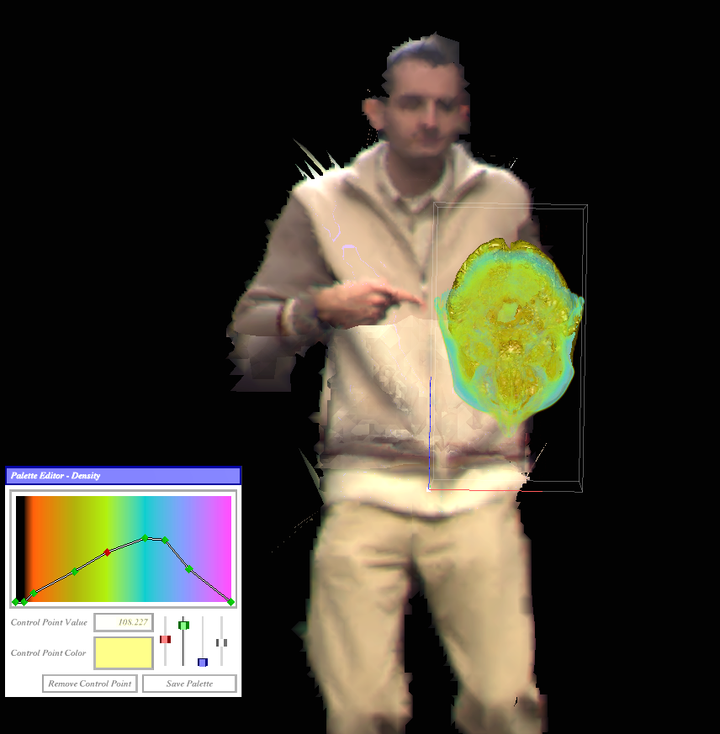
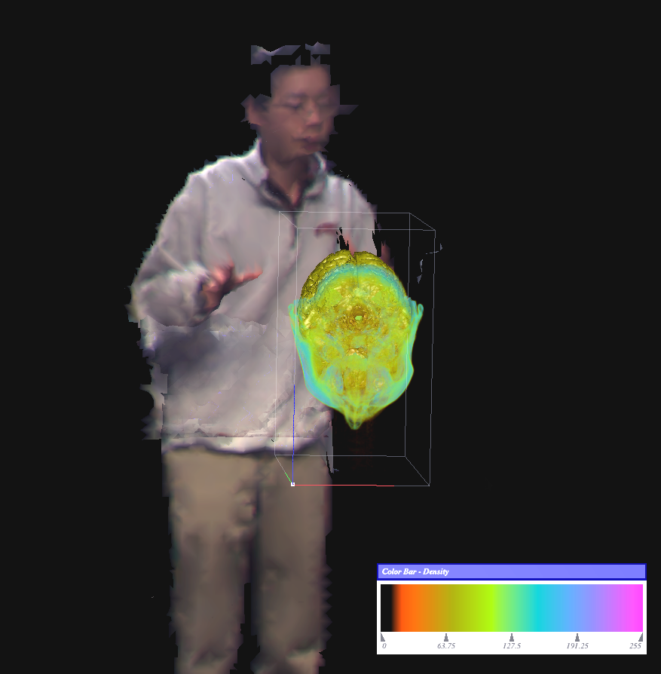
Teleimmersion system and MRI Data

Slide 9
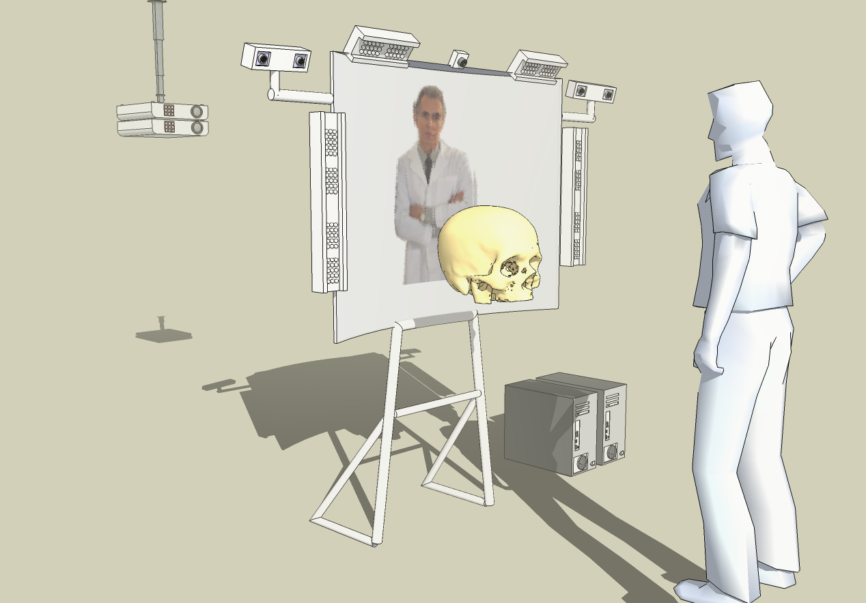
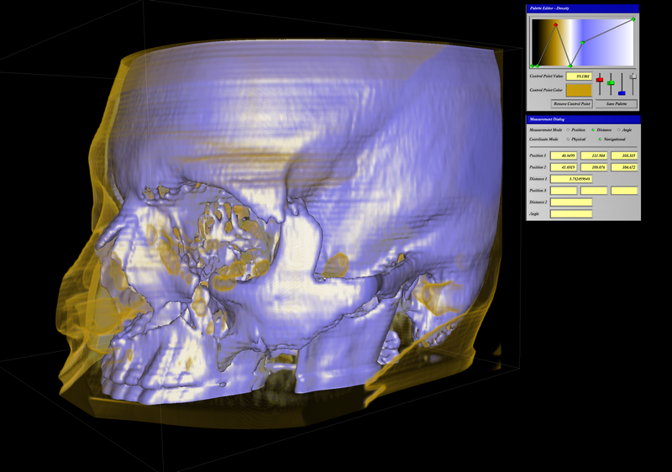
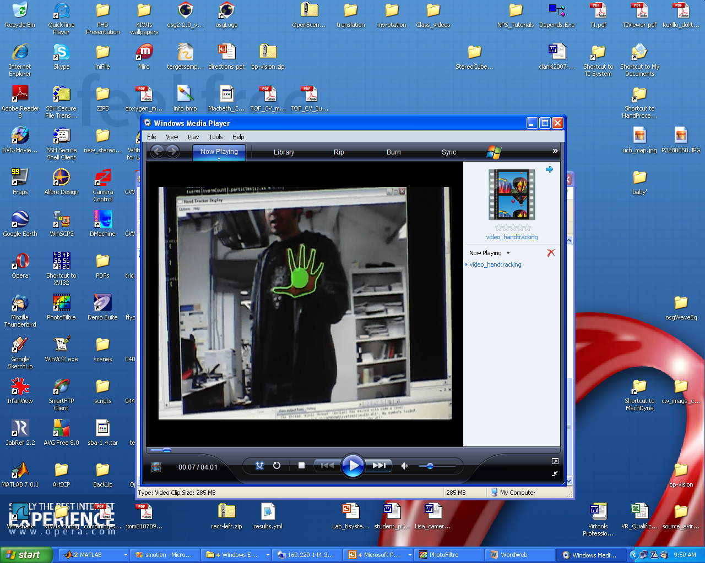
Remote Medical Collaboration
Two or more teleimmersive locations (UC Berkeley and UC Davis)
Collaborative work on volumetric data
Use of intuitive 3D interfaces

Slide 10
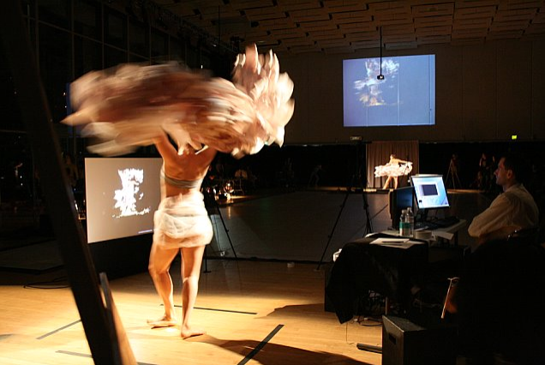
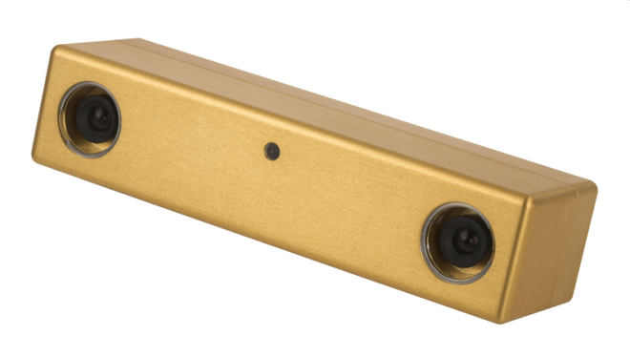
Portable Teleimmersion
Source: Point Grey, Inc.
Two teleimmersive locations
4 stereo cameras
Local network
Real environment (lights, shadows, people)
Live real-time streaming for 2hrs
Panorama: A Multimedia Happening, Source: Diana Kaljian

Slide 11
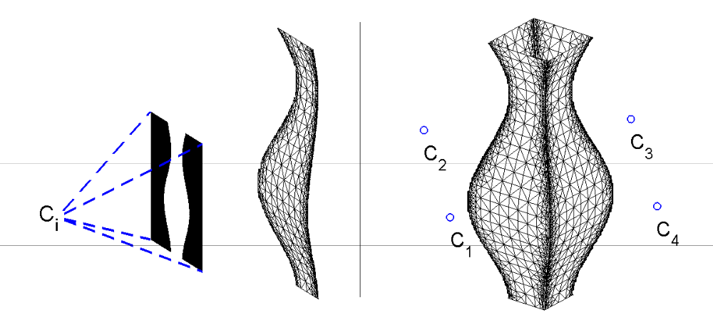
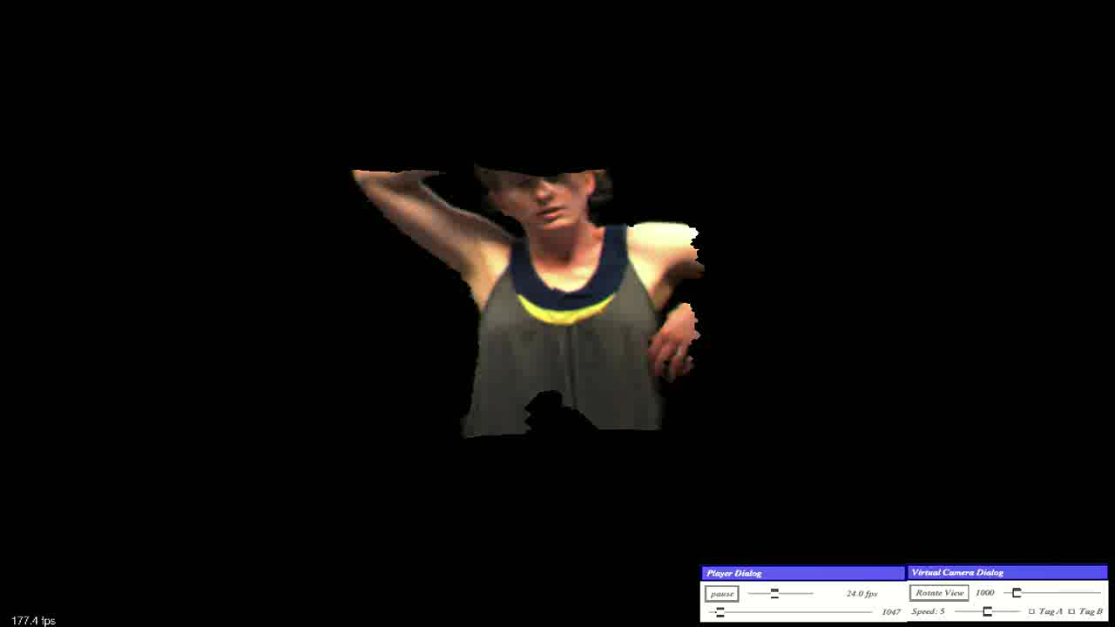
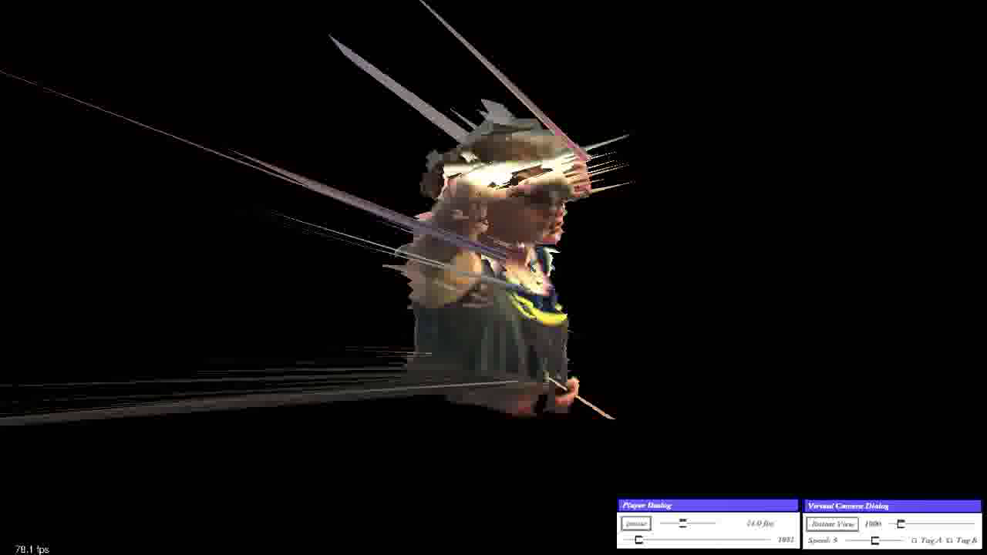
Rendering
Real-time rendering of meshes (~15k triangles)
Blending between multiple views using shaders
Merging partial 3D meshes into full model
Transformations on GPU -> x 2 speed-up

Slide 12
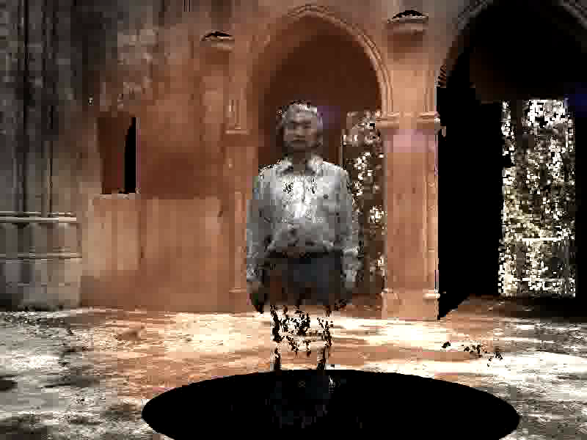
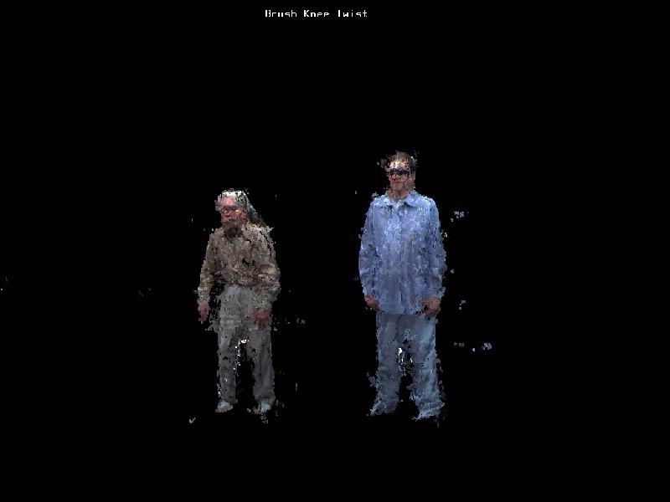
Point Cloud Rendering

Slide 13
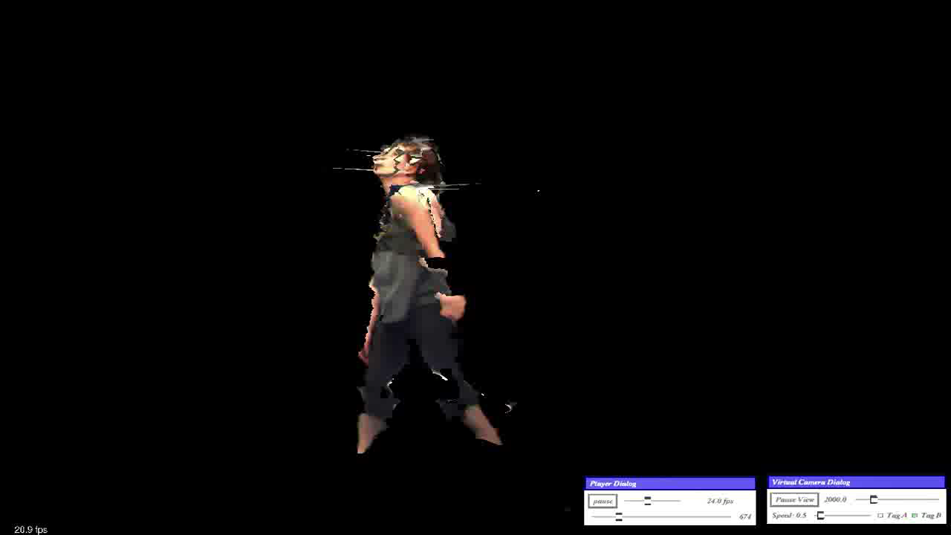
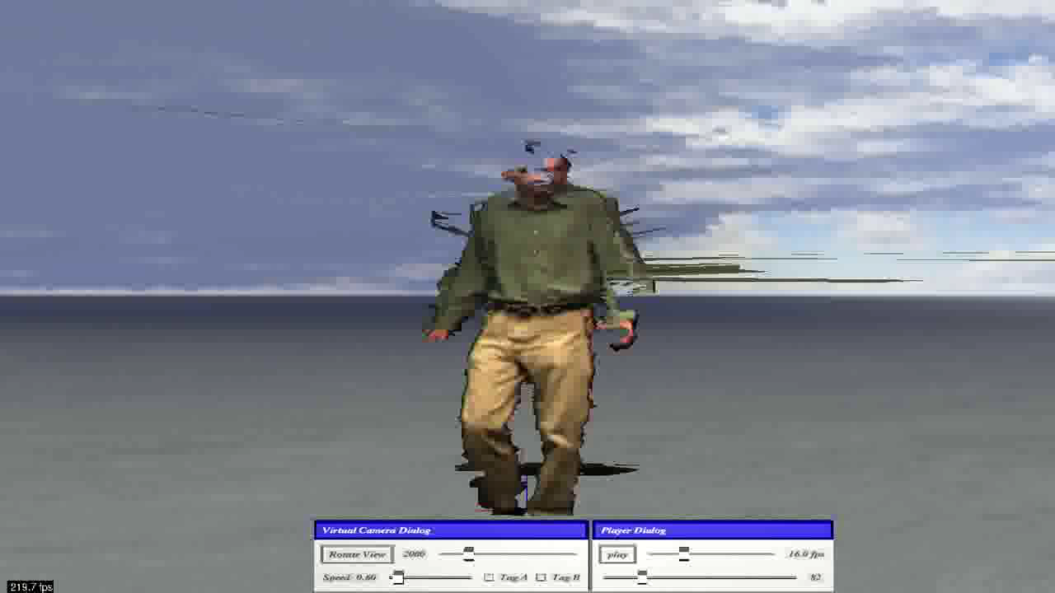
New Mesh Rendering

Slide 14
Conclusions and Future work
Real-time (20+ FPS) 3D capturing
Real-time collaboration over network
Accurate and efficient calibration approach
Future work:
Enhance INTERACTION
  Improved rendering
  Mesh merging for motion data analysis
  New techniques for compression

Slide 15
Thank You.

